Slide 1
Machine Learning for Price Prediction
- Ajinkya Phanse
- Sajeev Singh

Slide 2

Objective: In this project, our goal is to design and implement a machine learning-based trading strategy using LSTM (Long Short-Term Memory) models. Specifically, we aim to predict future asset prices and generate buy/sell signals for effective portfolio management. Project Plan: Data Preparation: We start with time-series datasets for multiple assets, perform data cleaning, and create relevant technical indicators to enhance model robustness. Model Training: Train individual LSTM models on historical price data for each asset to capture patterns and predict future prices. Signal Generation: Based on model predictions, generate buy/sell signals to simulate a trading strategy. Back testing and Evaluation: Test the effectiveness of our trading strategy by calculating cumulative returns and analyzing performance metrics. Upon successful completion of this project it will help in decision making- By predicting price trends, our model provides actionable buy/sell signals, enabling more informed trading decisions.

Slide 3
Data Preparation- Assets Selected- BTCUSD, ETHUSD, USA500.IDXUSD, XAUUSD, OJUICE.CMDUSX Reason for selecting these assets- Assets for LSTM must be volatile. We chose a diverse set of assets from different markets (cryptocurrency, stock index, precious metals, and agricultural commodities) to build a more robust, multi-asset trading strategy. This diversity helps test the model’s ability to adapt to different market behaviors and volatility patterns. Preparation steps- 1. Datetime Conversion: Parsed and standardized datetime format to ensure accurate time series alignment. 2. Feature Engineering- Technical Indicators: Added key indicators like Moving Averages (10, 50, 200 periods), Volatility, and Relative Strength Index (RSI). These indicators provide additional context about price trends, momentum, and market strength, which help improve model performance. 3. Scaling: Scaled features using MinMaxScaler to normalize data between 0 and 1. LSTM models perform better with normalized data, allowing the model to focus on patterns rather than raw values. 4. Sequence Creation: Transformed data into sequences of 60-time steps, creating input-output pairs for the LSTM model. This step allows the model to understand temporal dependencies and predict future prices based on historical patterns.

Slide 4
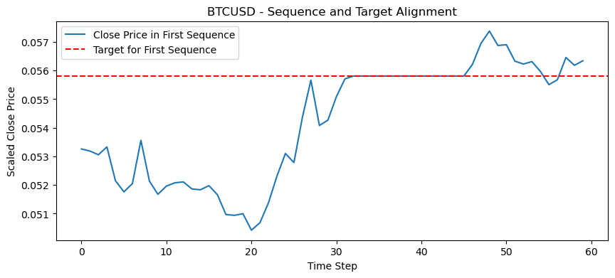
Data Quality Checks- 1. Handling of NaN values- NaN values appear when we did feature engineering due to rolling window calculations in feature engineering, especially technical indicators like Moving Averages and RSI, that require past data points 2. Sequence Integrity check- After data preparation, we converted the time series data into sequences to train the LSTM model. To ensure that each sequence and its corresponding target (the next price point) were aligned correctly, we performed a sequence alignment test. For each asset, we plotted the first sequence of prices alongside its target price. The sequence consists of the last 60 price points, and the target price is the next data point the model aims to predict. 3. Visualization- Blue line represents the Close prices in first sequence. Red line represents the target price that follows the sequence. As red dashed line aligns well with the trajectory of the blue line, confirming that the sequence aligns with its expected target. This alignment test verifies that our data sequencing is correctly implemented, ensuring accurate learning by the LSTM model.

Slide 5
Model Training- 1. We trained a separate LSTM model for each of the five selected assets (BTCUSD, ETHUSD, USA500.IDXUSD, XAUUSD, OJUICE.CMDUSX). Each model is customized to learn the unique patterns and trends in its respective asset’s price data. 2. Each model consists of two LSTM layers with 50 units each. This architecture is effective for capturing time dependencies in sequential data, allowing the model to understand past price movements and predict future ones. 3. A single Dense Layer with one neuron is used as output layer to predict next close price 4. Optimizer used is Adam and loss function implemented is – Mean Squared Error as it is standard for regression tasks and focuses on minimizing the average squared difference between the predicted and actual prices. 5. Epoch per model- Each model was trained for 20 epochs. This number of epochs strikes a balance between sufficient learning and avoiding overfitting, given the relatively large datasets and hourly data frequency. Batch size of 32 is chosen. 6. To make it more robust we have used a 20% Validation Set to avoid overfitting.

Slide 6
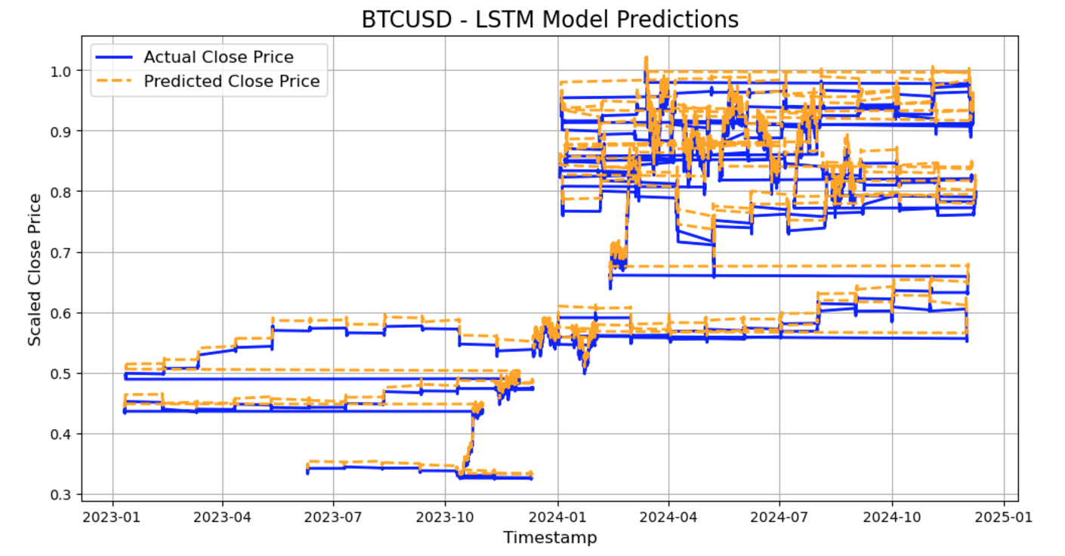
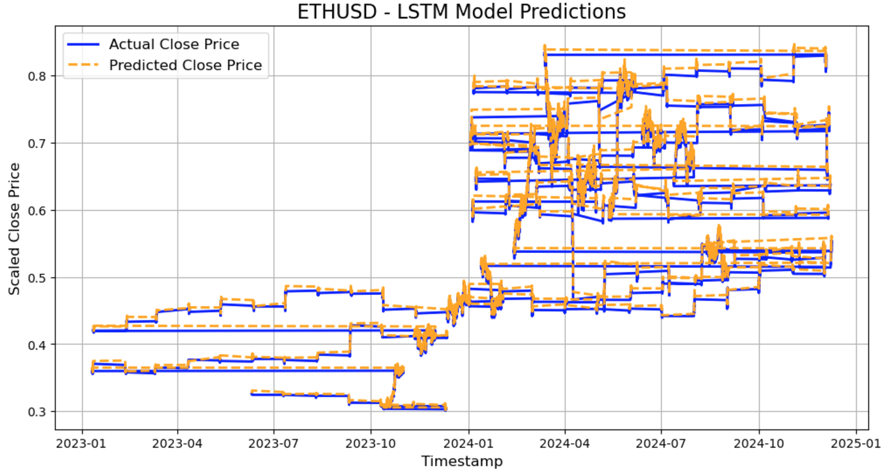
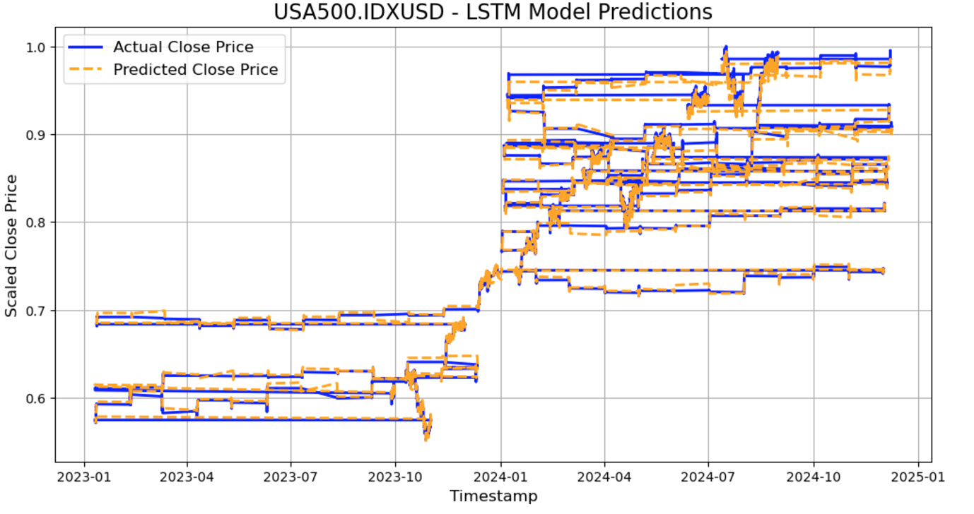
Model Evaluation- For each asset we have plotted the model’s predicted Close price (Orange) alongside the actual close price (Blue) in the test set. This allows to assess how well our model works.

Slide 7
Signal Generation and Backtesting- We developed and evaluated trading strategies using a structured, multi-phase approach that integrates predictive modelling and robust testing frameworks. The core objective was to design strategies that leverage both traditional technical indicators and machine learning predictions to improve trading outcomes while managing risks effectively. Our trading strategy was built in two phases: Phase 1: We applied momentum and MACD indicators to both historical price data and LSTM-predicted prices. This allowed us to assess the impact of machine learning predictions on traditional trading signals. Phase 2: We enhanced the LSTM-based strategies by incorporating trailing stop mechanisms to dynamically manage risk and lock in profits during volatile market conditions. To validate these strategies, we employed a comprehensive backtesting framework. The process involved: Signal Generation: Using calculated indicators or LSTM predictions to define buy, sell, and hold signals. Trade Execution: Simulating trades based on these signals, with clear entry and exit rules. Performance Evaluation: Measuring key metrics such as cumulative returns, Sharpe ratio, and maximum drawdown to assess the profitability and reliability of each strategy.

Slide 8
Phase 1 - Momentum Without LSTM Predictions We implemented a momentum-based trading strategy without using LSTM predictions to establish a baseline for comparison Momentum Calculation: Momentum was calculated as the difference between the current closing price and the closing price n periods ago: Momentum=Close(t)−Close(t−n) We tested different look-back periods (n) to balance responsiveness and noise. Signal Generation: Buy Signal (1): Generated when momentum > 0 (indicating upward trends). Sell Signal (-1): Generated when momentum < 0 (indicating downward trends). Hold Signal (0): Generated when momentum = 0. Backtesting: We simulated trades based on the generated signals: Opened long positions on buy signals and short positions on sell signals. Closed positions when the signal reversed. Evaluated performance using metrics like cumulative returns, Sharpe ratio, and maximum drawdown

Slide 9
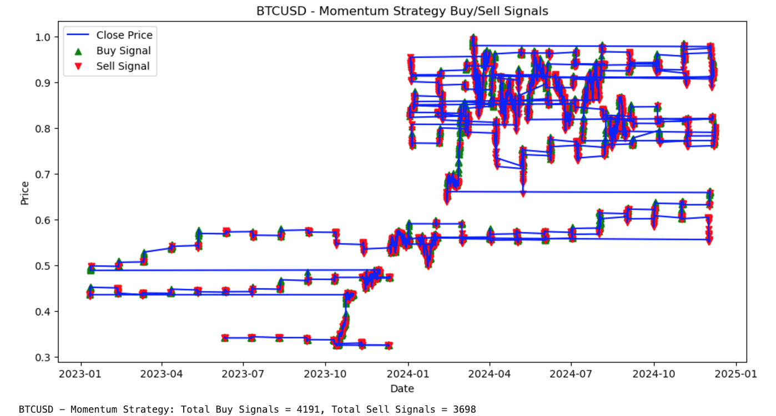
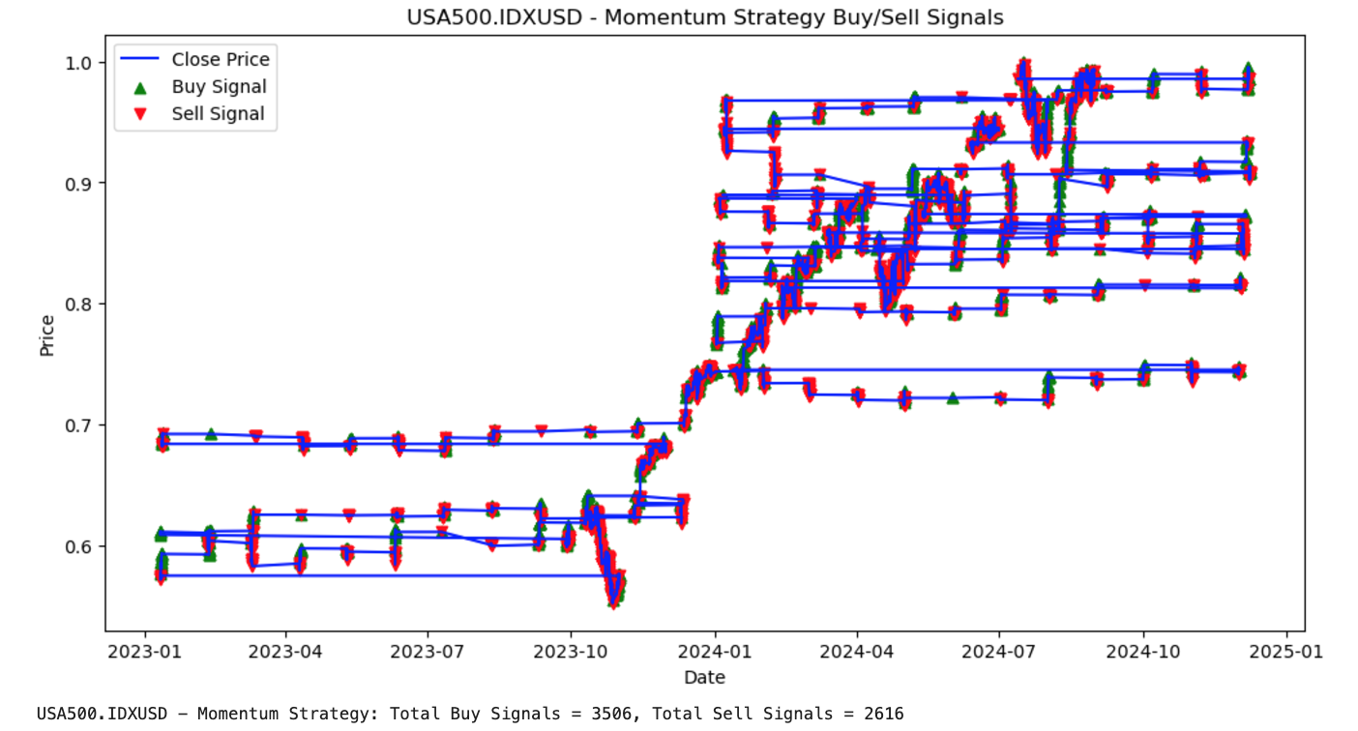
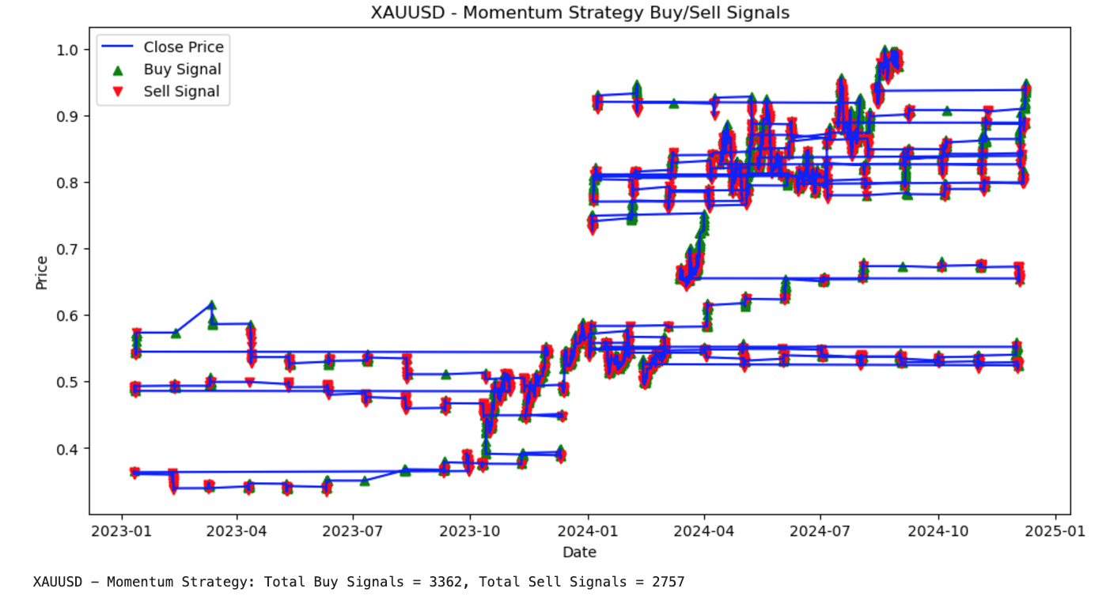
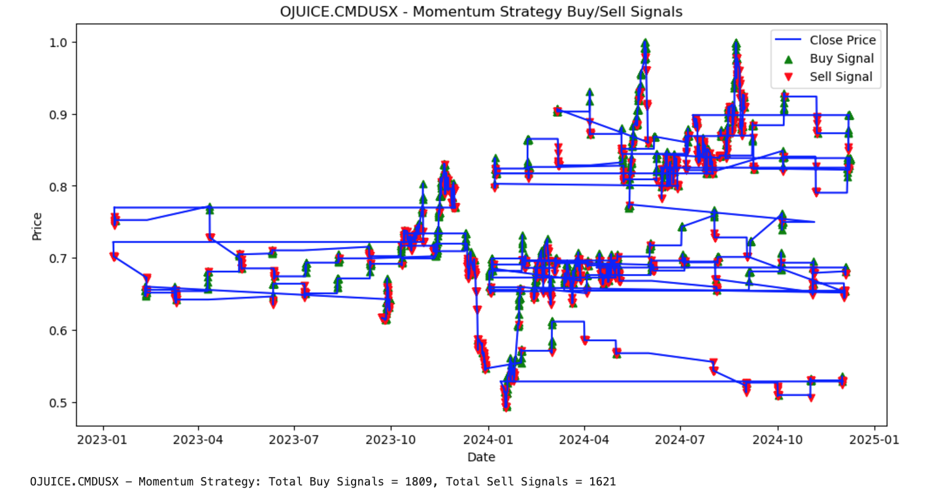
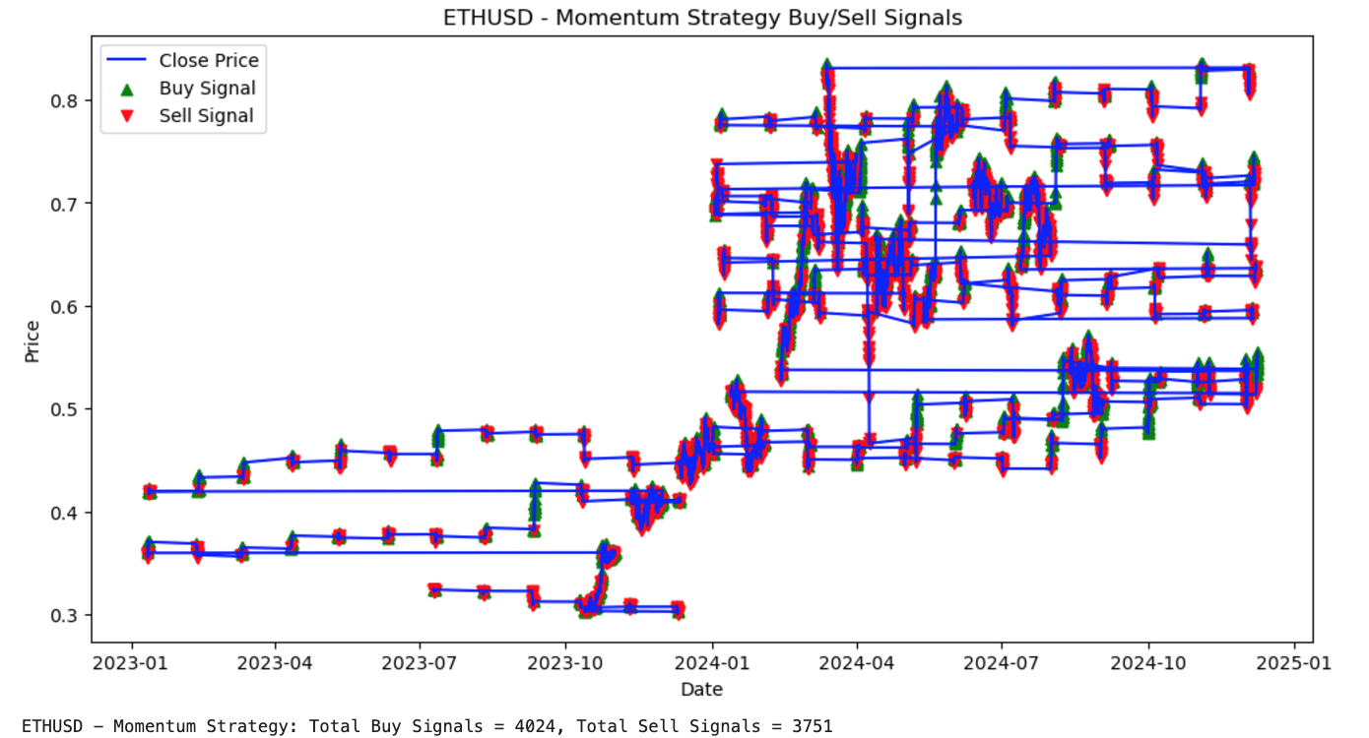
Phase 1 - Momentum Without LSTM Predictions (Results)

Slide 10
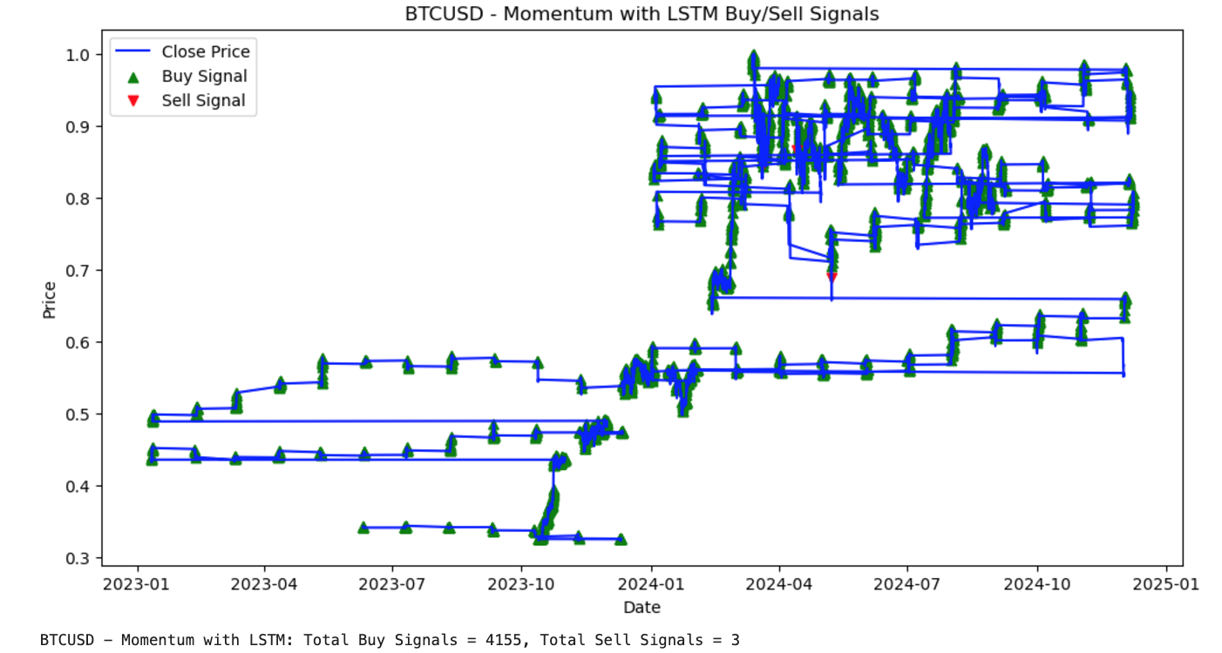
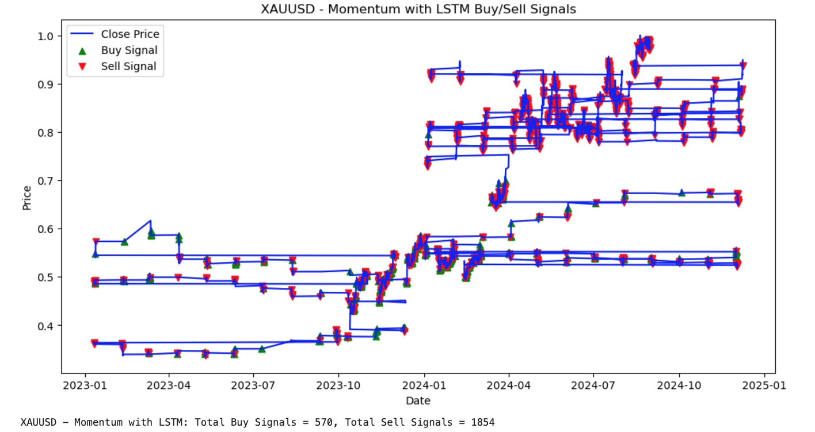
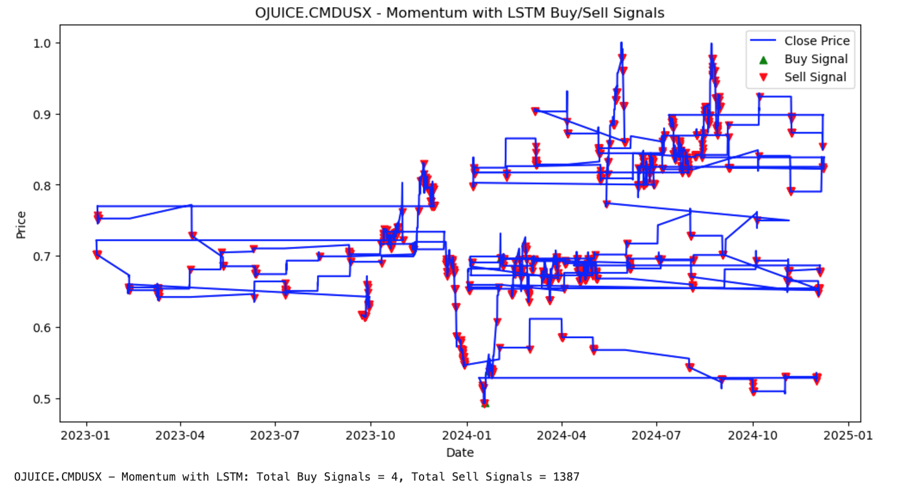
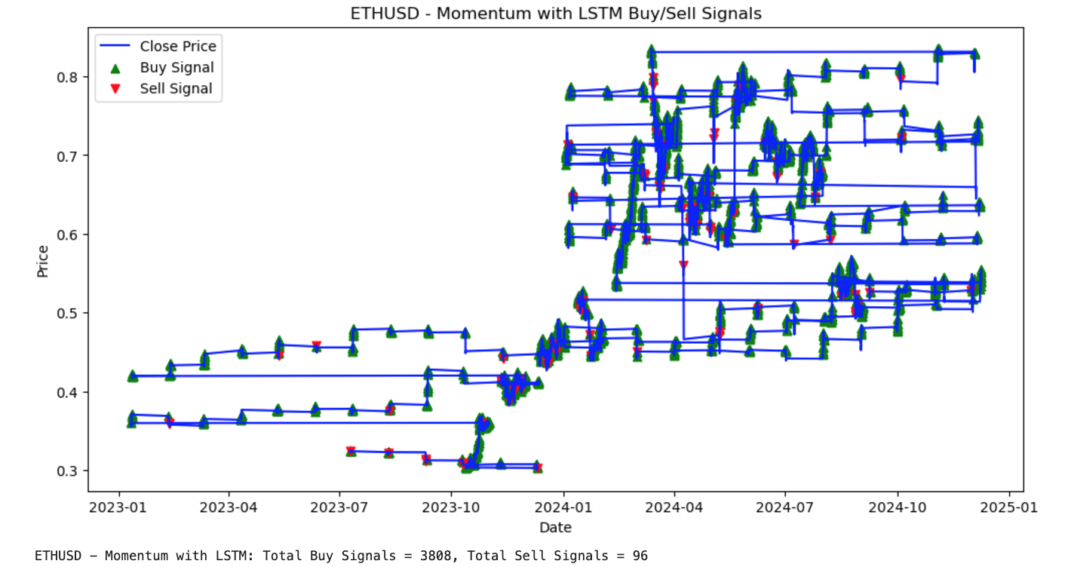
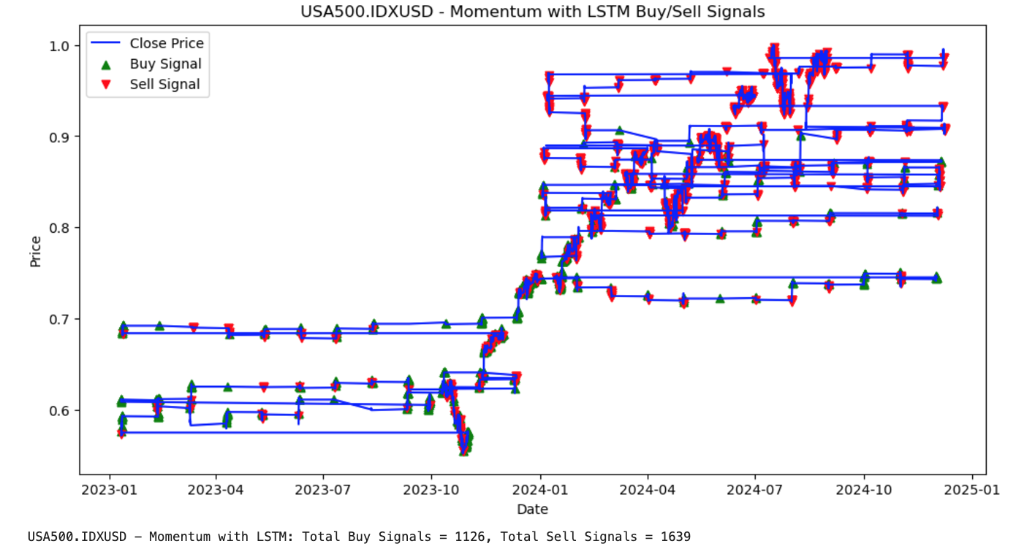
Phase 1 - Momentum With LSTM Predictions We enhanced the traditional momentum-based strategy by integrating predictions generated by a Long Short-Term Memory (LSTM) model. This approach aimed to leverage the predictive power of LSTM in forecasting future price movements and improving the effectiveness of momentum signals

Slide 11
Phase 1 - MACD Without LSTM Predictions we implemented a traditional MACD (Moving Average Convergence Divergence) trading strategy using historical price data. The goal was to establish a benchmark performance for MACD-based signals before integrating machine learning predictions in later phases Momentum Calculation: MACD indicator was computed using two exponential moving averages (EMAs) of the closing prices: Fast EMA: Calculated over a shorter period (e.g., 12 periods) Slow EMA: Calculated over a longer period (e.g., 26 periods) MACD Line=Fast EMA−Slow EMA Signal Generation: Buy Signal (1): Triggered when the MACD line crossed above the signal line, indicating upward momentum Sell Signal (-1): Triggered when the MACD line crossed below the signal line, indicating downward momentum Hold Signal (0): When no crossover occurred Backtesting: We simulated trades based on the generated signals: Opened long positions on buy signals and short positions on sell signals. Closed positions when the signal reversed. Evaluated performance using metrics like cumulative returns, Sharpe ratio, and maximum drawdown

Slide 12
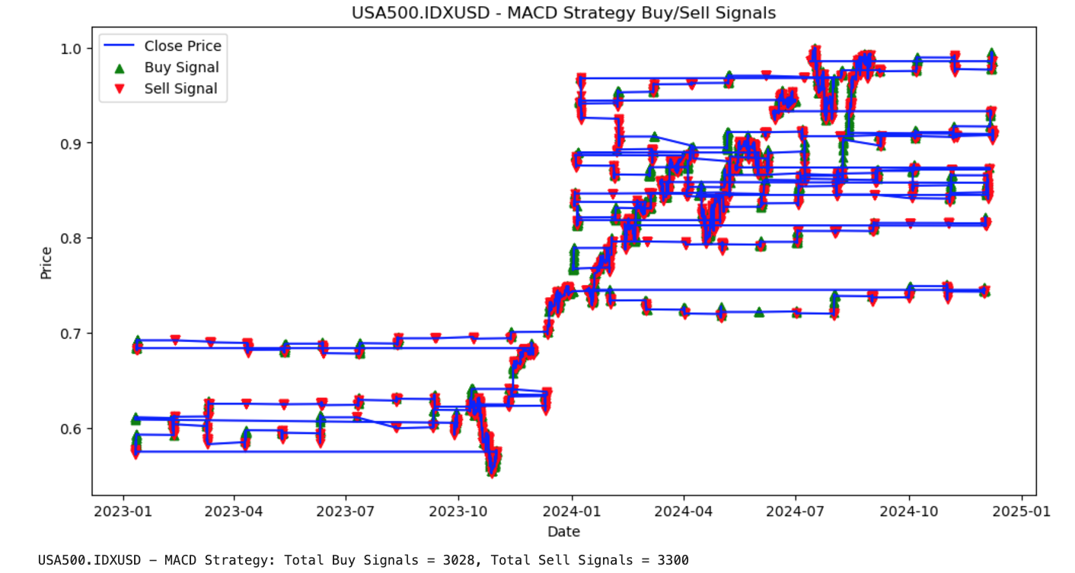
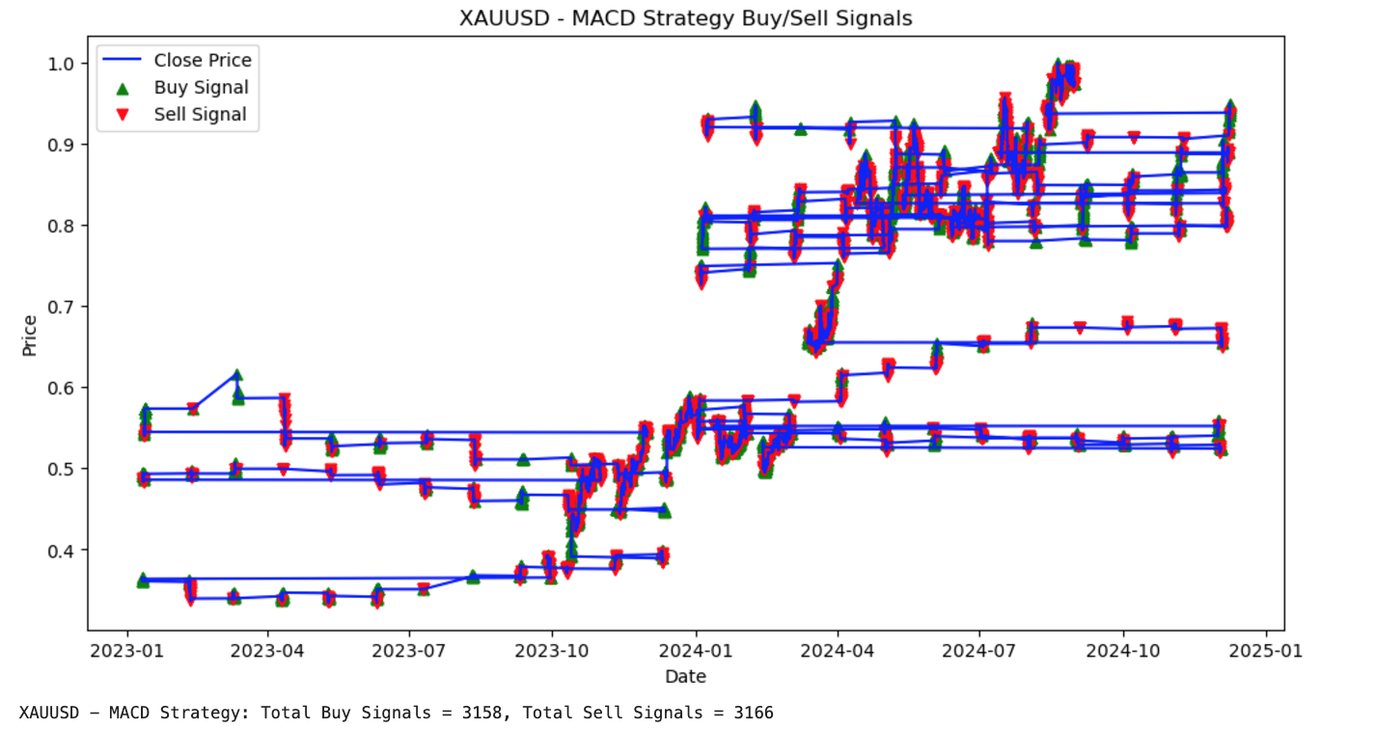

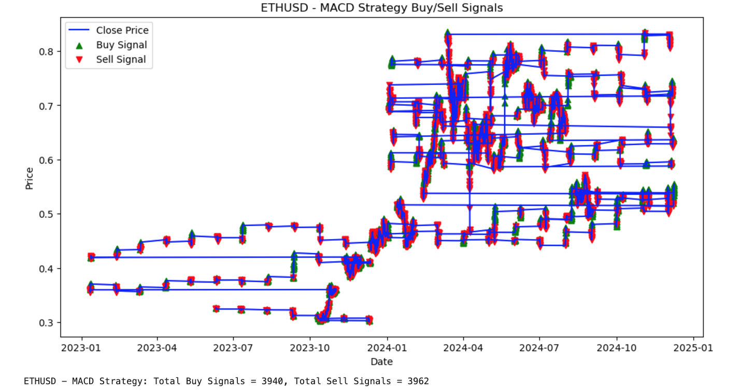
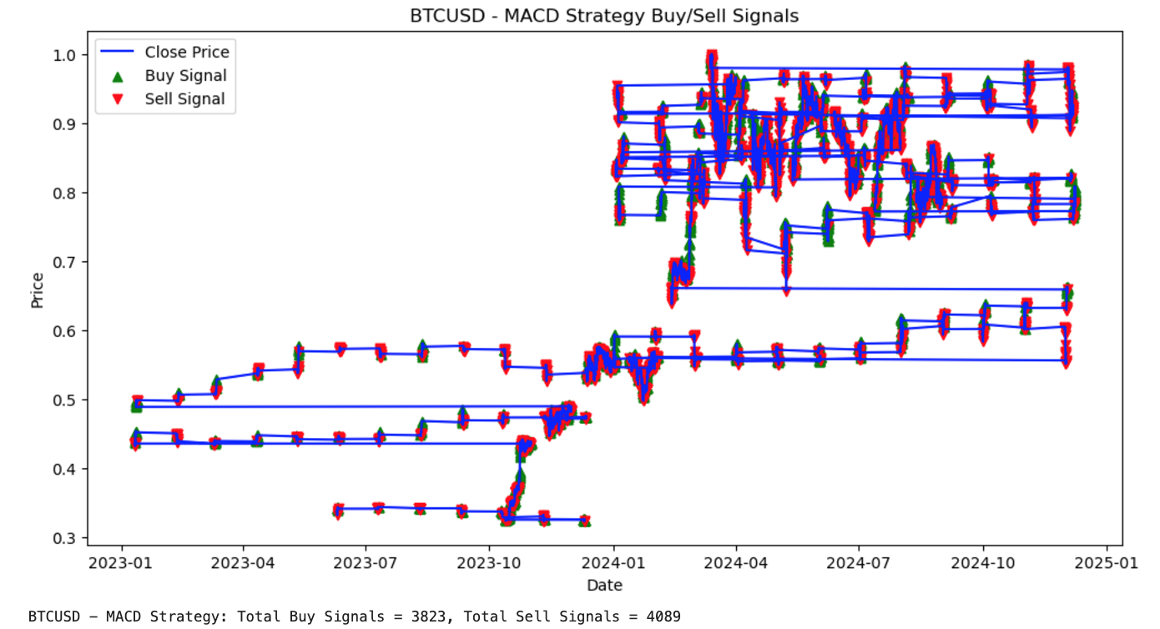
Phase 1 - MACD Without LSTM Predictions (Results)

Slide 13

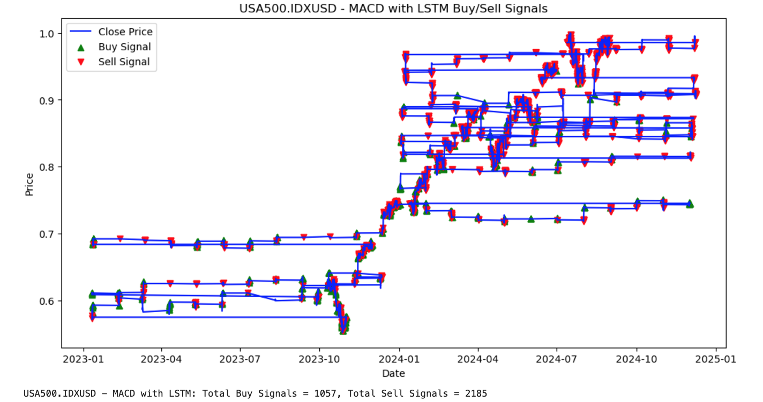
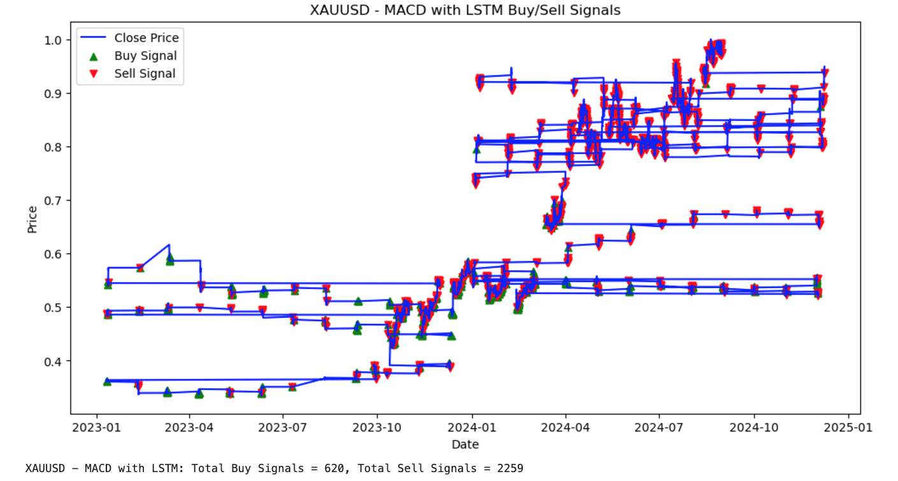
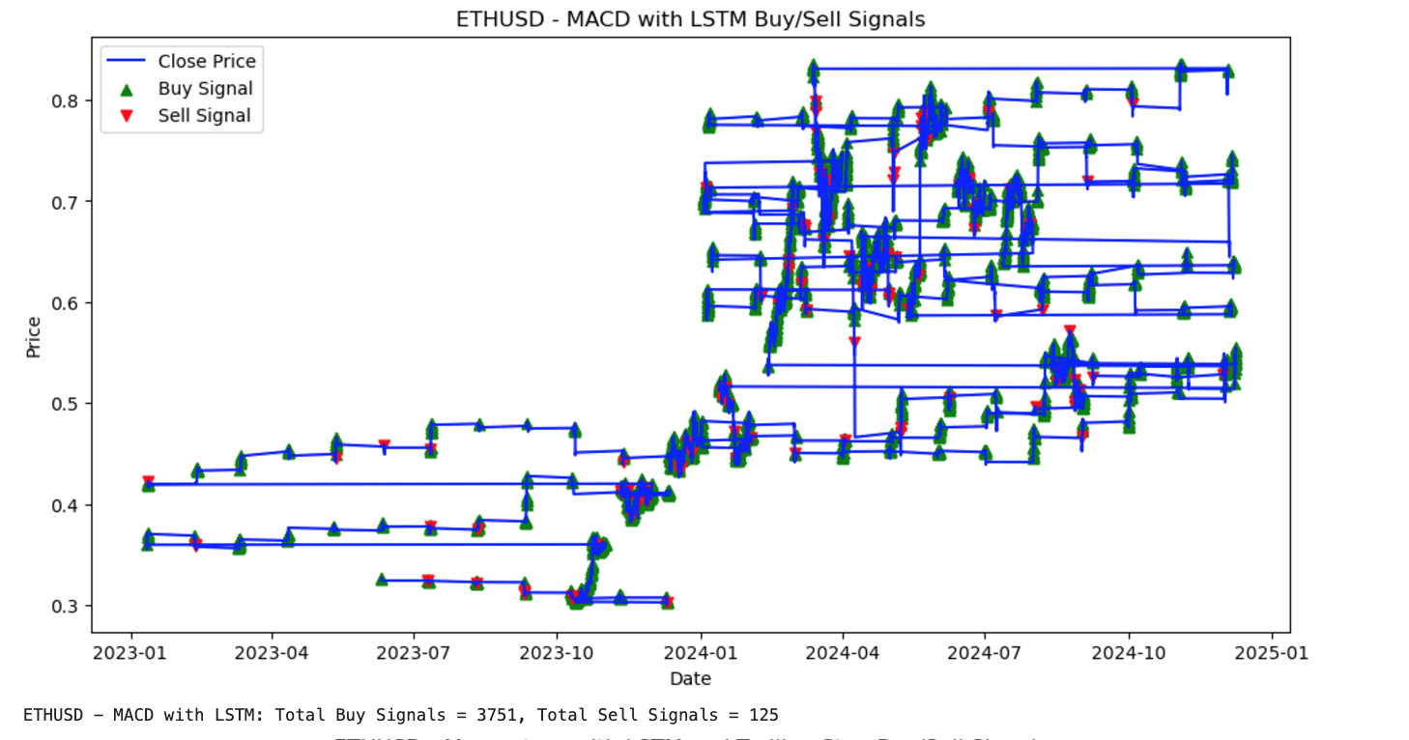
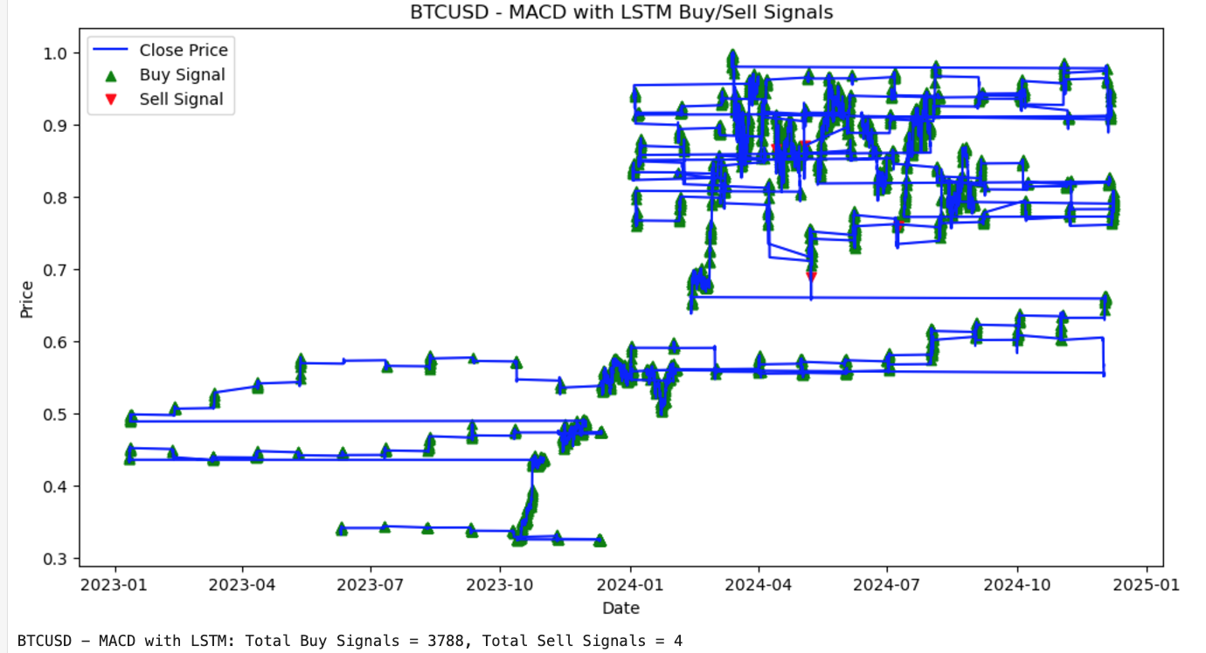
Phase 1 - MACD With LSTM Predictions We extended the traditional MACD strategy by utilizing LSTM-predicted closing prices to calculate the MACD and generate trading signals. This approach aimed to test whether machine learning predictions could enhance the effectiveness of MACD signals

Slide 14
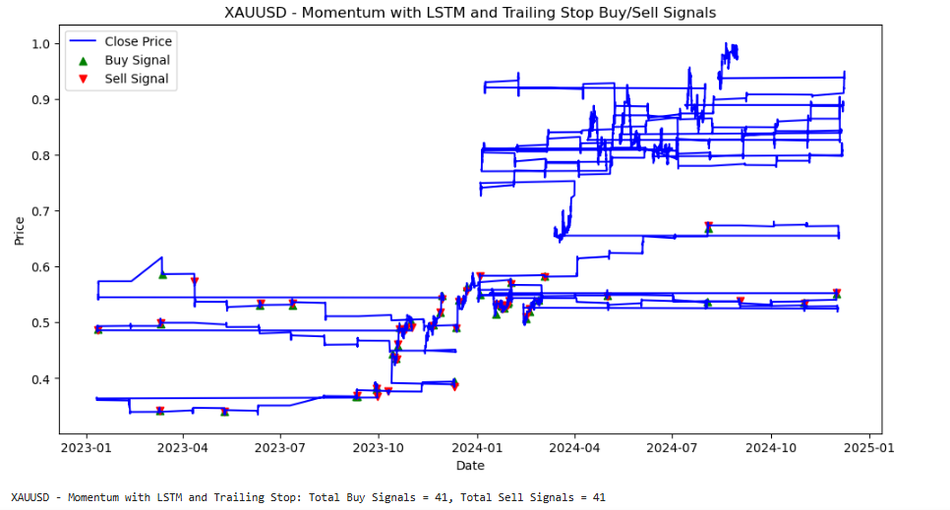
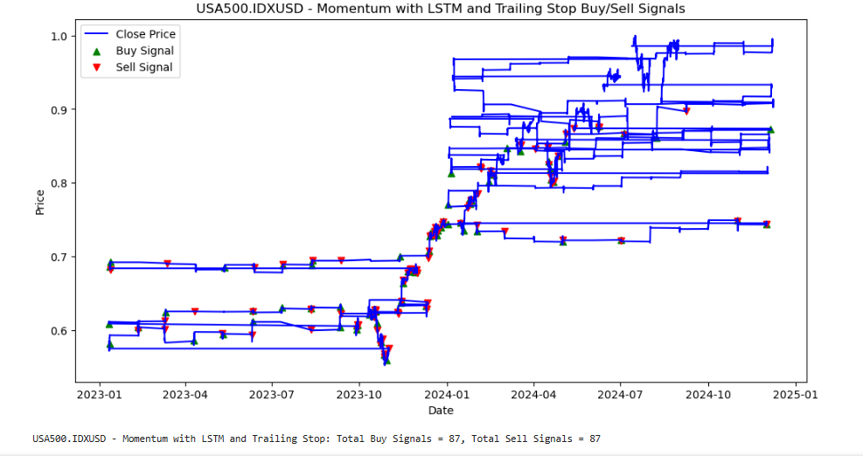
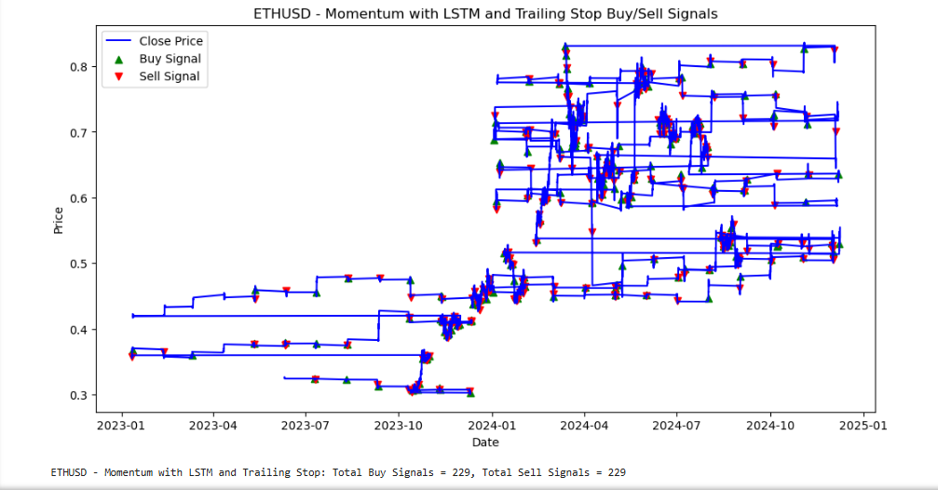
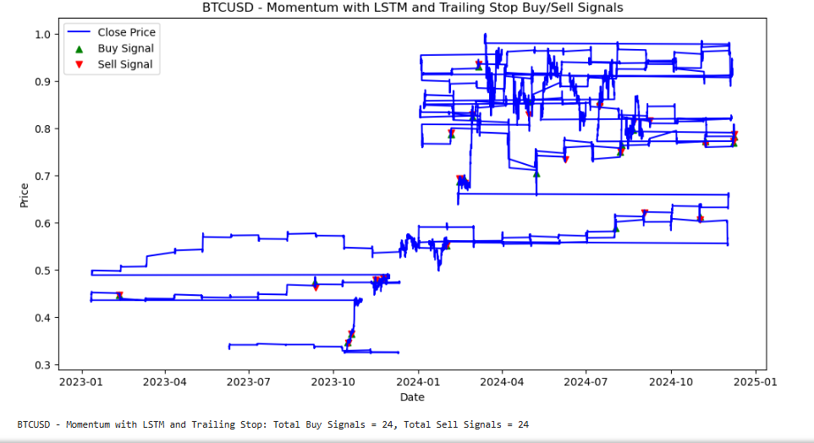
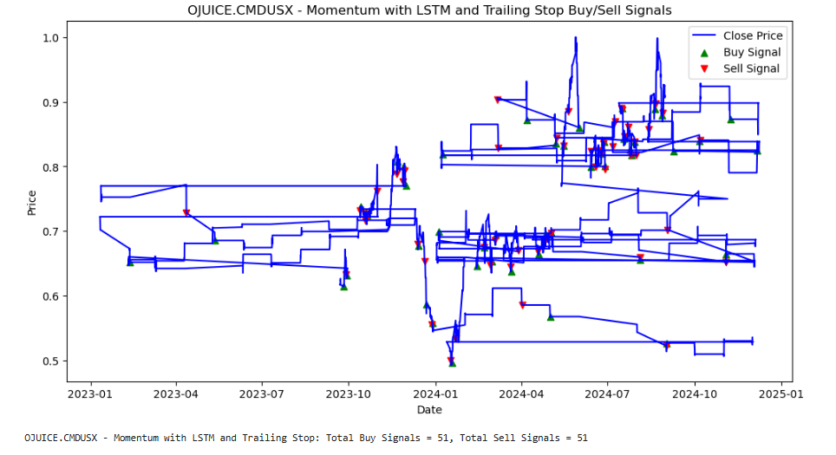
Phase 2 - Momentum With LSTM Predictions + Trailing Stop We built upon the momentum strategy using LSTM predictions by introducing a trailing stop mechanism. This enhancement aimed to dynamically manage risk, lock in profits, and mitigate losses during volatile market conditions A dynamic trailing stop was implemented to adjust stop-loss levels as prices moved favourably: For long positions, the stop-loss increased with rising prices but stayed fixed during price drops For short positions, the stop-loss decreased with falling prices but stayed fixed during price increases

Slide 15
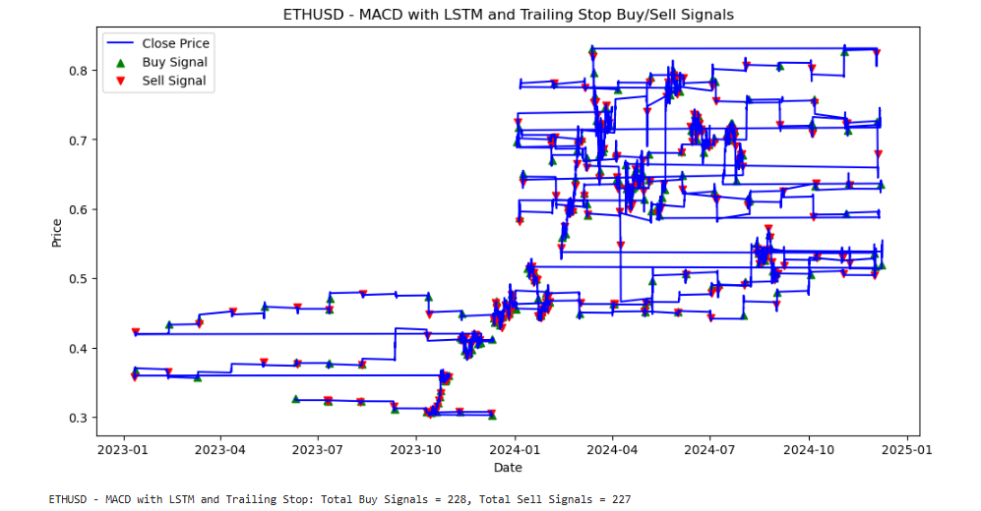
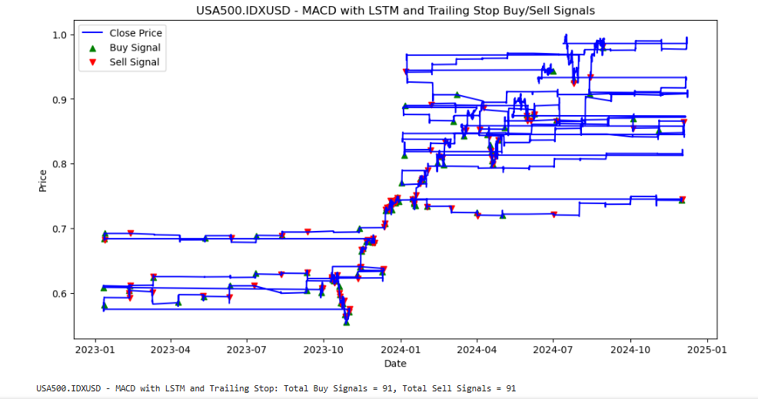
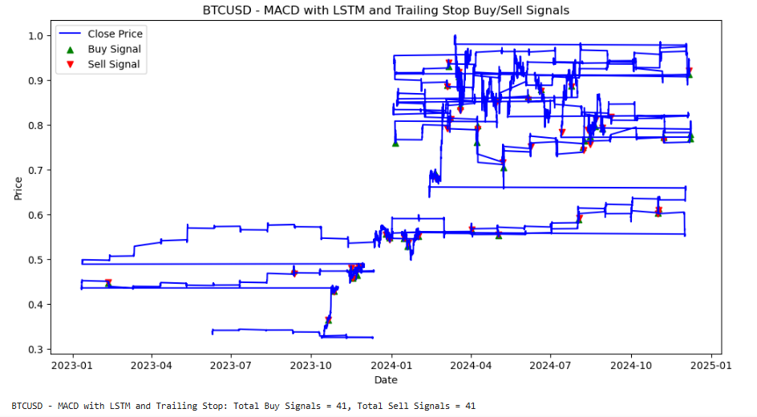
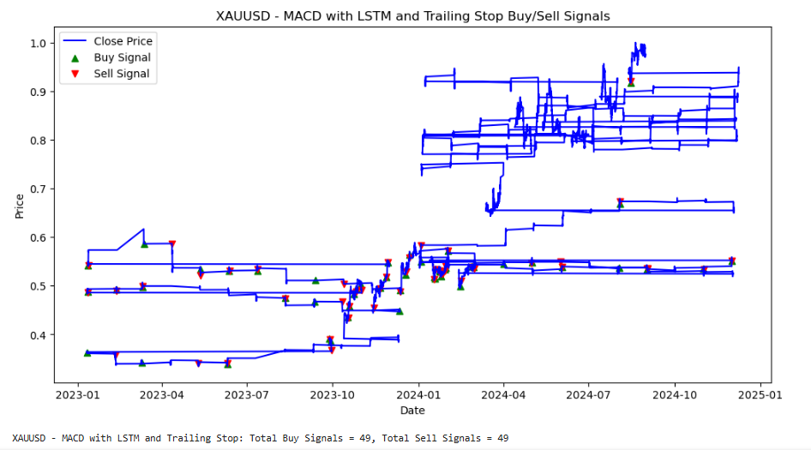
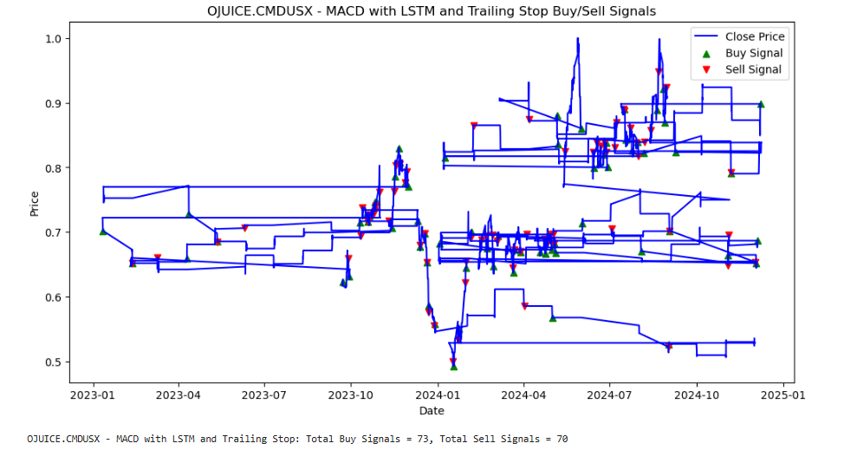
Phase 2 - MACD With LSTM Predictions + Trailing Stop We enhanced the MACD strategy by integrating LSTM-predicted prices and incorporating a trailing stop mechanism. This phase aimed to improve both trade entry accuracy and risk management, making the strategy more robust and adaptable to market conditions A dynamic trailing stop was implemented to adjust stop-loss levels as prices moved favourably: For long positions, the stop-loss increased with rising prices but stayed fixed during price drops For short positions, the stop-loss decreased with falling prices but stayed fixed during price increases

Slide 16
Backtesting Results
Asset | Phase | Strategy | Final Balance | Cumulative Return | Max Drawdown
BTCUSD | Phase1 | MOM_Without_LSTM | 16138.65698 | 0.613866 | -0.489285
BTCUSD | Phase1 | MOM_With_LSTM | 18234.56 | 1.172265 | -0.676681
BTCUSD | Phase1 | MACD_Without_LSTM | 17348.24913 | 0.734825 | -0.508833
BTCUSD | Phase1 | MACD_With_LSTM | 21233.00061 | 1.1233 | -0.670637
BTCUSD | Phase2 | MOM_With_LSTM_Trailing_Stop | 18534.34734
BTCUSD | Phase2 | MACD_With_LSTM_Trailing_Stop | 20209.71048
ETHUSD | Phase1 | MOM_Without_LSTM | 20037.43233 | 1.003743 | -0.631102
ETHUSD | Phase1 | MOM_With_LSTM | 15120.8525 | 0.512085 | -0.608211
ETHUSD | Phase1 | MACD_Without_LSTM | 17454.42506 | 0.745443 | -0.52167
ETHUSD | Phase1 | MACD_With_LSTM | 14975.42218 | 0.497542 | -0.595295
ETHUSD | Phase2 | MOM_With_LSTM_Trailing_Stop | 13796.04753
ETHUSD | Phase2 | MACD_With_LSTM_Trailing_Stop | 15028.95993
USA500.IDXUSD | Phase1 | MOM_Without_LSTM | 12587.07451 | 0.258707 | -0.307605
USA500.IDXUSD | Phase1 | MOM_With_LSTM | 13005.64814 | 0.300565 | -0.269719
USA500.IDXUSD | Phase1 | MACD_Without_LSTM | 13236.66219 | 0.323666 | -0.315448
USA500.IDXUSD | Phase1 | MACD_With_LSTM | 12598.59274 | 0.259859 | -0.257215
USA500.IDXUSD | Phase2 | MOM_With_LSTM_Trailing_Stop | 13005.64814
USA500.IDXUSD | Phase2 | MACD_With_LSTM_Trailing_Stop | 12598.59274
XAUUSD | Phase1 | MOM_With_LSTM | 18494.6635 | 0.849466 | -0.524327
XAUUSD | Phase1 | MOM_Without_LSTM | 13403.29256 | 0.340329 | -0.353816
XAUUSD | Phase1 | MACD_Without_LSTM | 19048.11016 | 0.904811 | -0.54248
XAUUSD | Phase1 | MACD_With_LSTM | 9844.138866 | -0.015586 | -0.206442
XAUUSD | Phase2 | MOM_With_LSTM_Trailing_Stop | 13183.12366
XAUUSD | Phase2 | MACD_With_LSTM_Trailing_Stop | 10381.21565
OJUICE.CMDUSX | Phase1 | MOM_With_LSTM | 21902.33591 | 1.190234 | -0.562633
OJUICE.CMDUSX | Phase1 | MOM_Without_LSTM | 10921.56843 | 0.092157 | -0.119957
OJUICE.CMDUSX | Phase1 | MACD_With_LSTM | 9942.723616 | -0.005728 | -0.470022
OJUICE.CMDUSX | Phase1 | MACD_Without_LSTM | 11135.94839 | 0.113595 | -0.177067
OJUICE.CMDUSX | Phase2 | MOM_With_LSTM_Trailing_Stop | 10827.85644
OJUICE.CMDUSX | Phase2 | MACD_With_LSTM_Trailing_Stop | 11152.69106

Slide 17
1. LSTM Predictions LSTM predictions significantly enhanced momentum-based strategies, especially for BTCUSD and OJUICE.CMDUSX in Phase 1. However, their effectiveness was inconsistent across assets. For MACD strategies, LSTM predictions underperformed for some assets, such as XAUUSD, due to its volatile or inconsistent price trends 2. Momentum vs. MACD Momentum-based strategies outperformed MACD strategies, particularly when combined with LSTM predictions. MACD struggled in volatile markets like ETHUSD and XAUUSD, where trends were less stable, leading to delayed or suboptimal signals 3. Trailing Stops Trailing stops improved risk management by limiting drawdowns but often capped profits in trending markets like BTCUSD. While they worked well for ETHUSD and OJUICE.CMDUSX in Phase 2, their effectiveness varied depending on market conditions 4. Simplicity vs. Complexity Simpler strategies like Momentum Without LSTM performed exceptionally well, particularly for OJUICE.CMDUSX. While LSTM added predictive power, it did not universally outperform simpler approaches, as seen in ETHUSD and XAUUSD, where mixed results were observed 5. Asset Volatility and Strategy Suitability For high-volatility assets like BTCUSD, LSTM-enhanced strategies captured trends effectively, delivering high returns. Conversely, MACD strategies struggled in volatile environments. In stable markets like OJUICE.CMDUSX, simpler momentum strategies consistently achieved strong returns and low drawdowns
KEY CONCLUSIONS

Slide 18
6. Drawdown Performance MACD strategies, especially with LSTM, were less effective during drawdowns, as they rely on lagging signals that miss sharp reversals. XAUUSD in Phase 1 - MACD With LSTM experienced the highest loss due to this limitation 7. Diversification Benefits The variation in strategy performance highlights the importance of diversification. BTCUSD delivered the highest returns with significant drawdowns, while OJUICE.CMDUSX provided stable returns that offset losses from volatile assets like XAUUSD 8. Predictive Power of LSTM LSTM predictions enhanced momentum strategies but were inconsistent for MACD-based approaches. Fine-tuning LSTM models for specific assets could further improve results, as their effectiveness depends on market structure and trend patterns
KEY CONCLUSIONS (Contd.)

Slide 19

Thank You

